Slide 1
Future (to be going to)
To talk about future plans and arrangements
P. 165 & 173

Slide 2
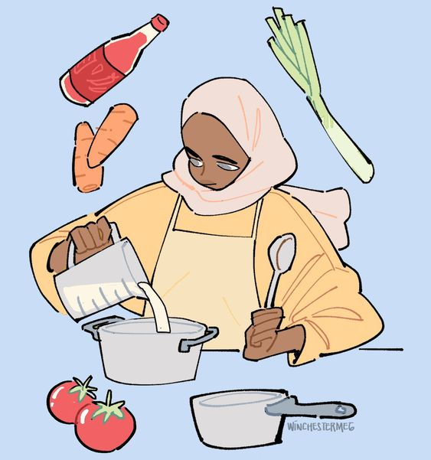
The rule ->
To be + going to + infinitive verb
To be -> am, is and are.
Not
going to
I -> AM
You -> ARE
He -> IS
She -> IS
It -> IS
We -> ARE
They -> ARE
play tennis with my friends.
watch a movie with Chris.
cook pizza for dinner.
help the old lady.

Slide 3
What NOT to do ->
I am going to be watching a movie with a friend. -> FOUT
I am going to watch a movie with a friend -> GOED
*Uitleg
Regel is -> To be + going to + infinitive
EN NIET -> To be + going to + be+ing

Slide 4
Demonstrative pronoun
To talk about specific things or people.
P. 166 & 173

Slide 5
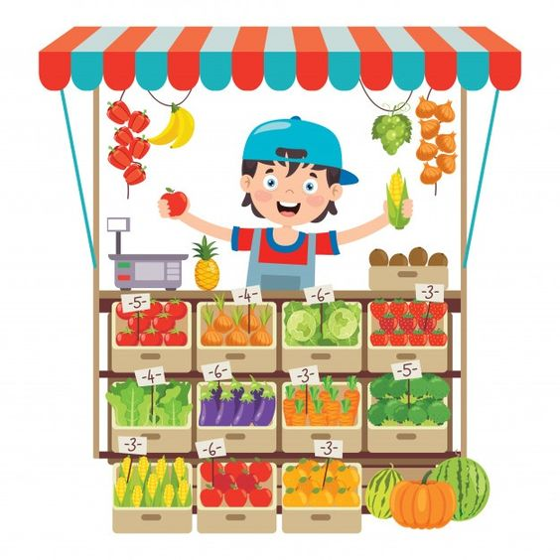
If something is nearby
If something is further away
(Over there, across the room, behind the counter)
Singular -> That
Plural -> Those
Can you pass me that book over there?
Do you know those people across the room?
(Over here, next to me, right here)
Singular -> This
Plural -> These
You can still drink this tea hot.
I would like this broccoli here.
Can I have these apples?

